Slide 1
Tackling procrastination: It’s easier, and more valuable, than you think
Barbara Oakley, PhD

Slide 2
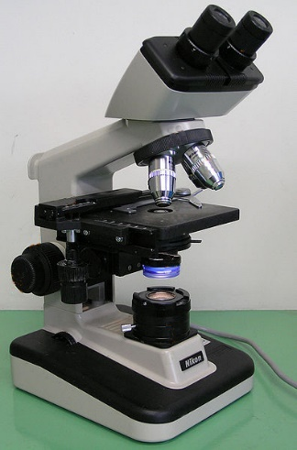
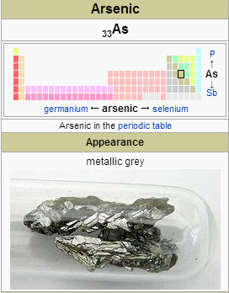
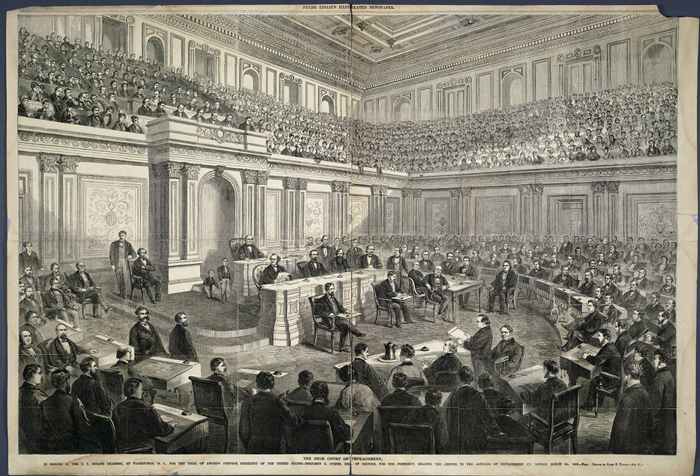

Slide 3
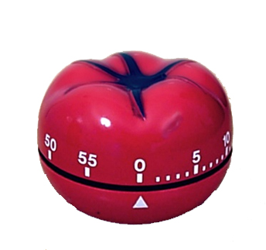

Slide 4
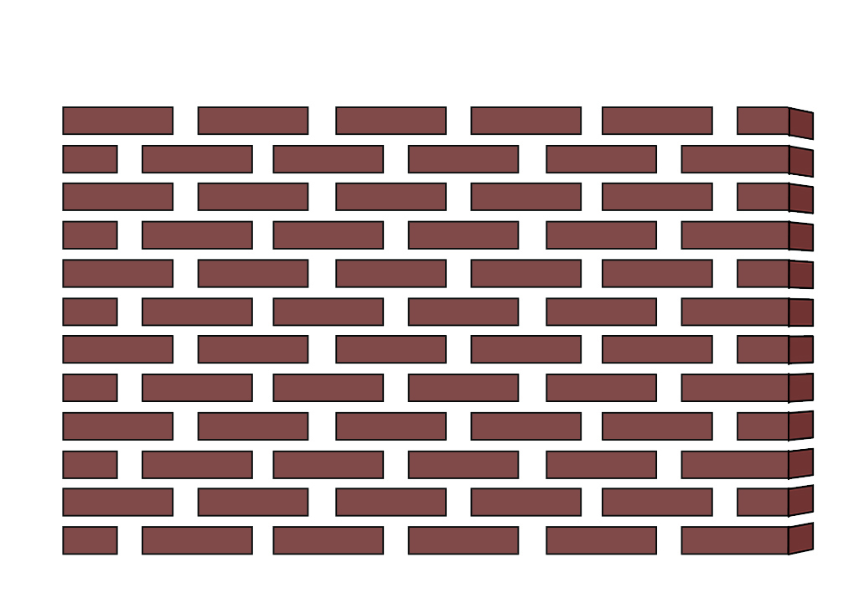


Slide 5
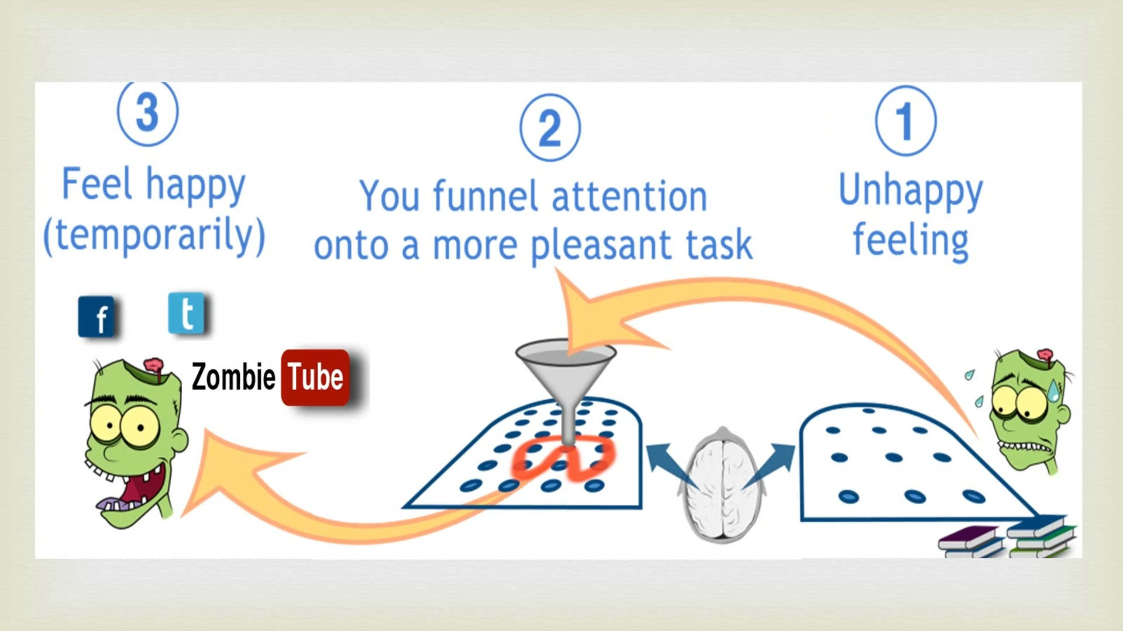

Slide 6
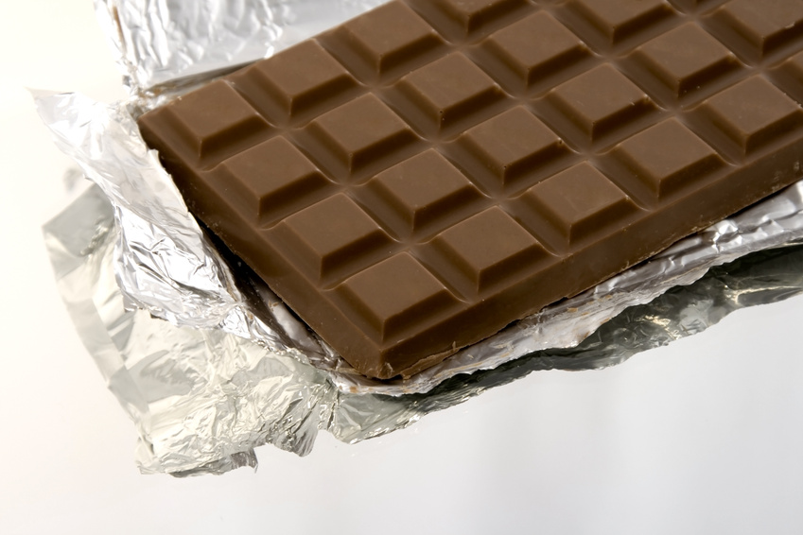

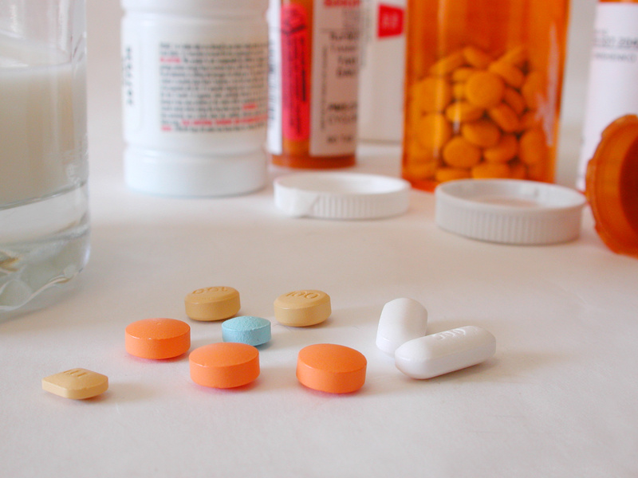

Slide 7
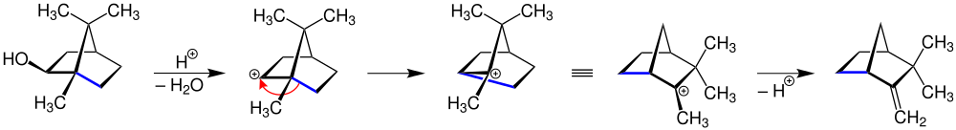

Slide 9
Image Credits
Arsenic images from http://en.wikipedia.org/wiki/Arsenic
The US Senate Chamber in 1868, Courtesy the Cornell University Library via the Commons on Flickr, via http://susanbarsy.com/tag/us-presidency/. (Okay, it’s not the 48th meeting of the German Association of Arts and Sciences in 1875, but it gives a bit of a sense of the era…)
Pomodoro timer, Pomodoro timer, Autore: Francesco Cirillo rilasciata a Erato nelle sottostanti
licenze seguirÃ OTRS, http://en.wikipedia.org/wiki/File:Il_pomodoro.jpg
Brick wall ©Kevin Mendez, 2014.
Procrastination funneling ©Kevin Mendez, 2014.
http://commons.wikimedia.org/wiki/File:Optical_microscope_nikon_alphaphot_+.jpg, author, GcG(jawp).
Wagner-Meerwein rearrangement, http://en.wikipedia.org/wiki/Wagner-Meerwein_rearrangement, A Wagner–Meerwein rearrangement is a class of carbocation 1,2-rearrangement reactions in which a hydrogen, alkyl or aryl group migrates from one carbon to a neighboring carbon
Clip art courtesy Microsoft Corporation
Relevant Readings
Ainslie, G., and N. Haslam. "Self-Control." In Choice over Time, edited by G. Loewenstein and J. Elster NY: Russell Sage Foundation, 1992.
Boice, Robert. Procrastination and Blocking. Westport, CT: Praeger, 1996.
Chu, Angela, and Jin Name Choi. "Rethinking Procrastination: Positive Effects of 'Active' Procrastination Behavior on Attitudes and Performance." Journal of Social Psychology 145, no. 3 (2005): 245-64.
Duhigg, Charles. The Power of Habit. NY: Random House, 2012.
Ellenbogen, J.M., P.T. Hu, J.D. Payne, D. Titone, and M.P. Walker. "Human Relational Memory Requires Time and Sleep." PNAS 104, no. 18 (2007): 7723-28.
Emmett, Rita. The Procrastinator's Handbook. NY: Walker & Company, 2000.
Emsley, J. The Elements of Murder. NY: Oxford University Press, 2005.
Fiore, Neil A. The Now Habit. NY: Penguin, 2007.
Graham, Paul. "Good and Bad Procrastination." http://paulgraham.com/procrastination.html.
Lyons, I.M., and S.L. Beilock. "When Math Hurts: Math Anxiety Predicts Pain Network Activation in Anticipation of Doing Math." PLoS ONE 7, no. 10 (2012): e48076.
Partnoy, F. Wait. NY: PublicAffairs, 2012.
Steel, Piers. "The Nature of Procrastination: A Meta-Analytic and Theoretical Review of Quintessential Self-Regulatory Failure." Psychological Bulletin 133, no. 1 (Jan 2007): 65-94.
———. The Procrastination Equation. NY: Random House, 2010.
Tice, D.M., and R.F. Baumeister. "Longitudinal Study of Procrastination, Performance, Stress, and Health: The Costs and Benefits of Dawdling." Psychological Science 8, no. 6 (1997): 454-58.

